Slide 1
Online News
Presented by:
Zeeshan Muzammal BSCS13010
Ayesha Asghar BSCS13033
Arslan Ahmad BSCS13023
Abdul Monam BSCS13039
Presented To:
Dr. Zubair Malik

Slide 2
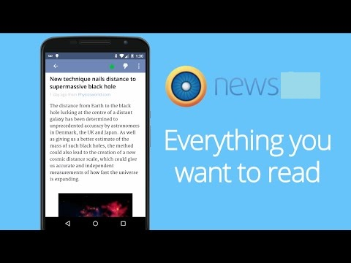
Value Proposition
“All unbiased news along with Personalized News”

Slide 3
Problem
Most of the people get news that are biased toward specific people or society. All available sources of news provide separate news about same topic that confuses people. Some people want to see news only related to their interests.

Slide 4
Solution
Providing an mobile app that will provide news using tweets of people anchor and news channels. User can also make his profile there to get news related to his/her interest. This would be unbiased because it will give news and comparison with other news channels at the same time.

Slide 5
Three Tasks
Simple
A user wants to see all news of the days.
Medium
A user want to see hot news of specific time.
Complex
A user want to see news related to his interests.

Slide 6
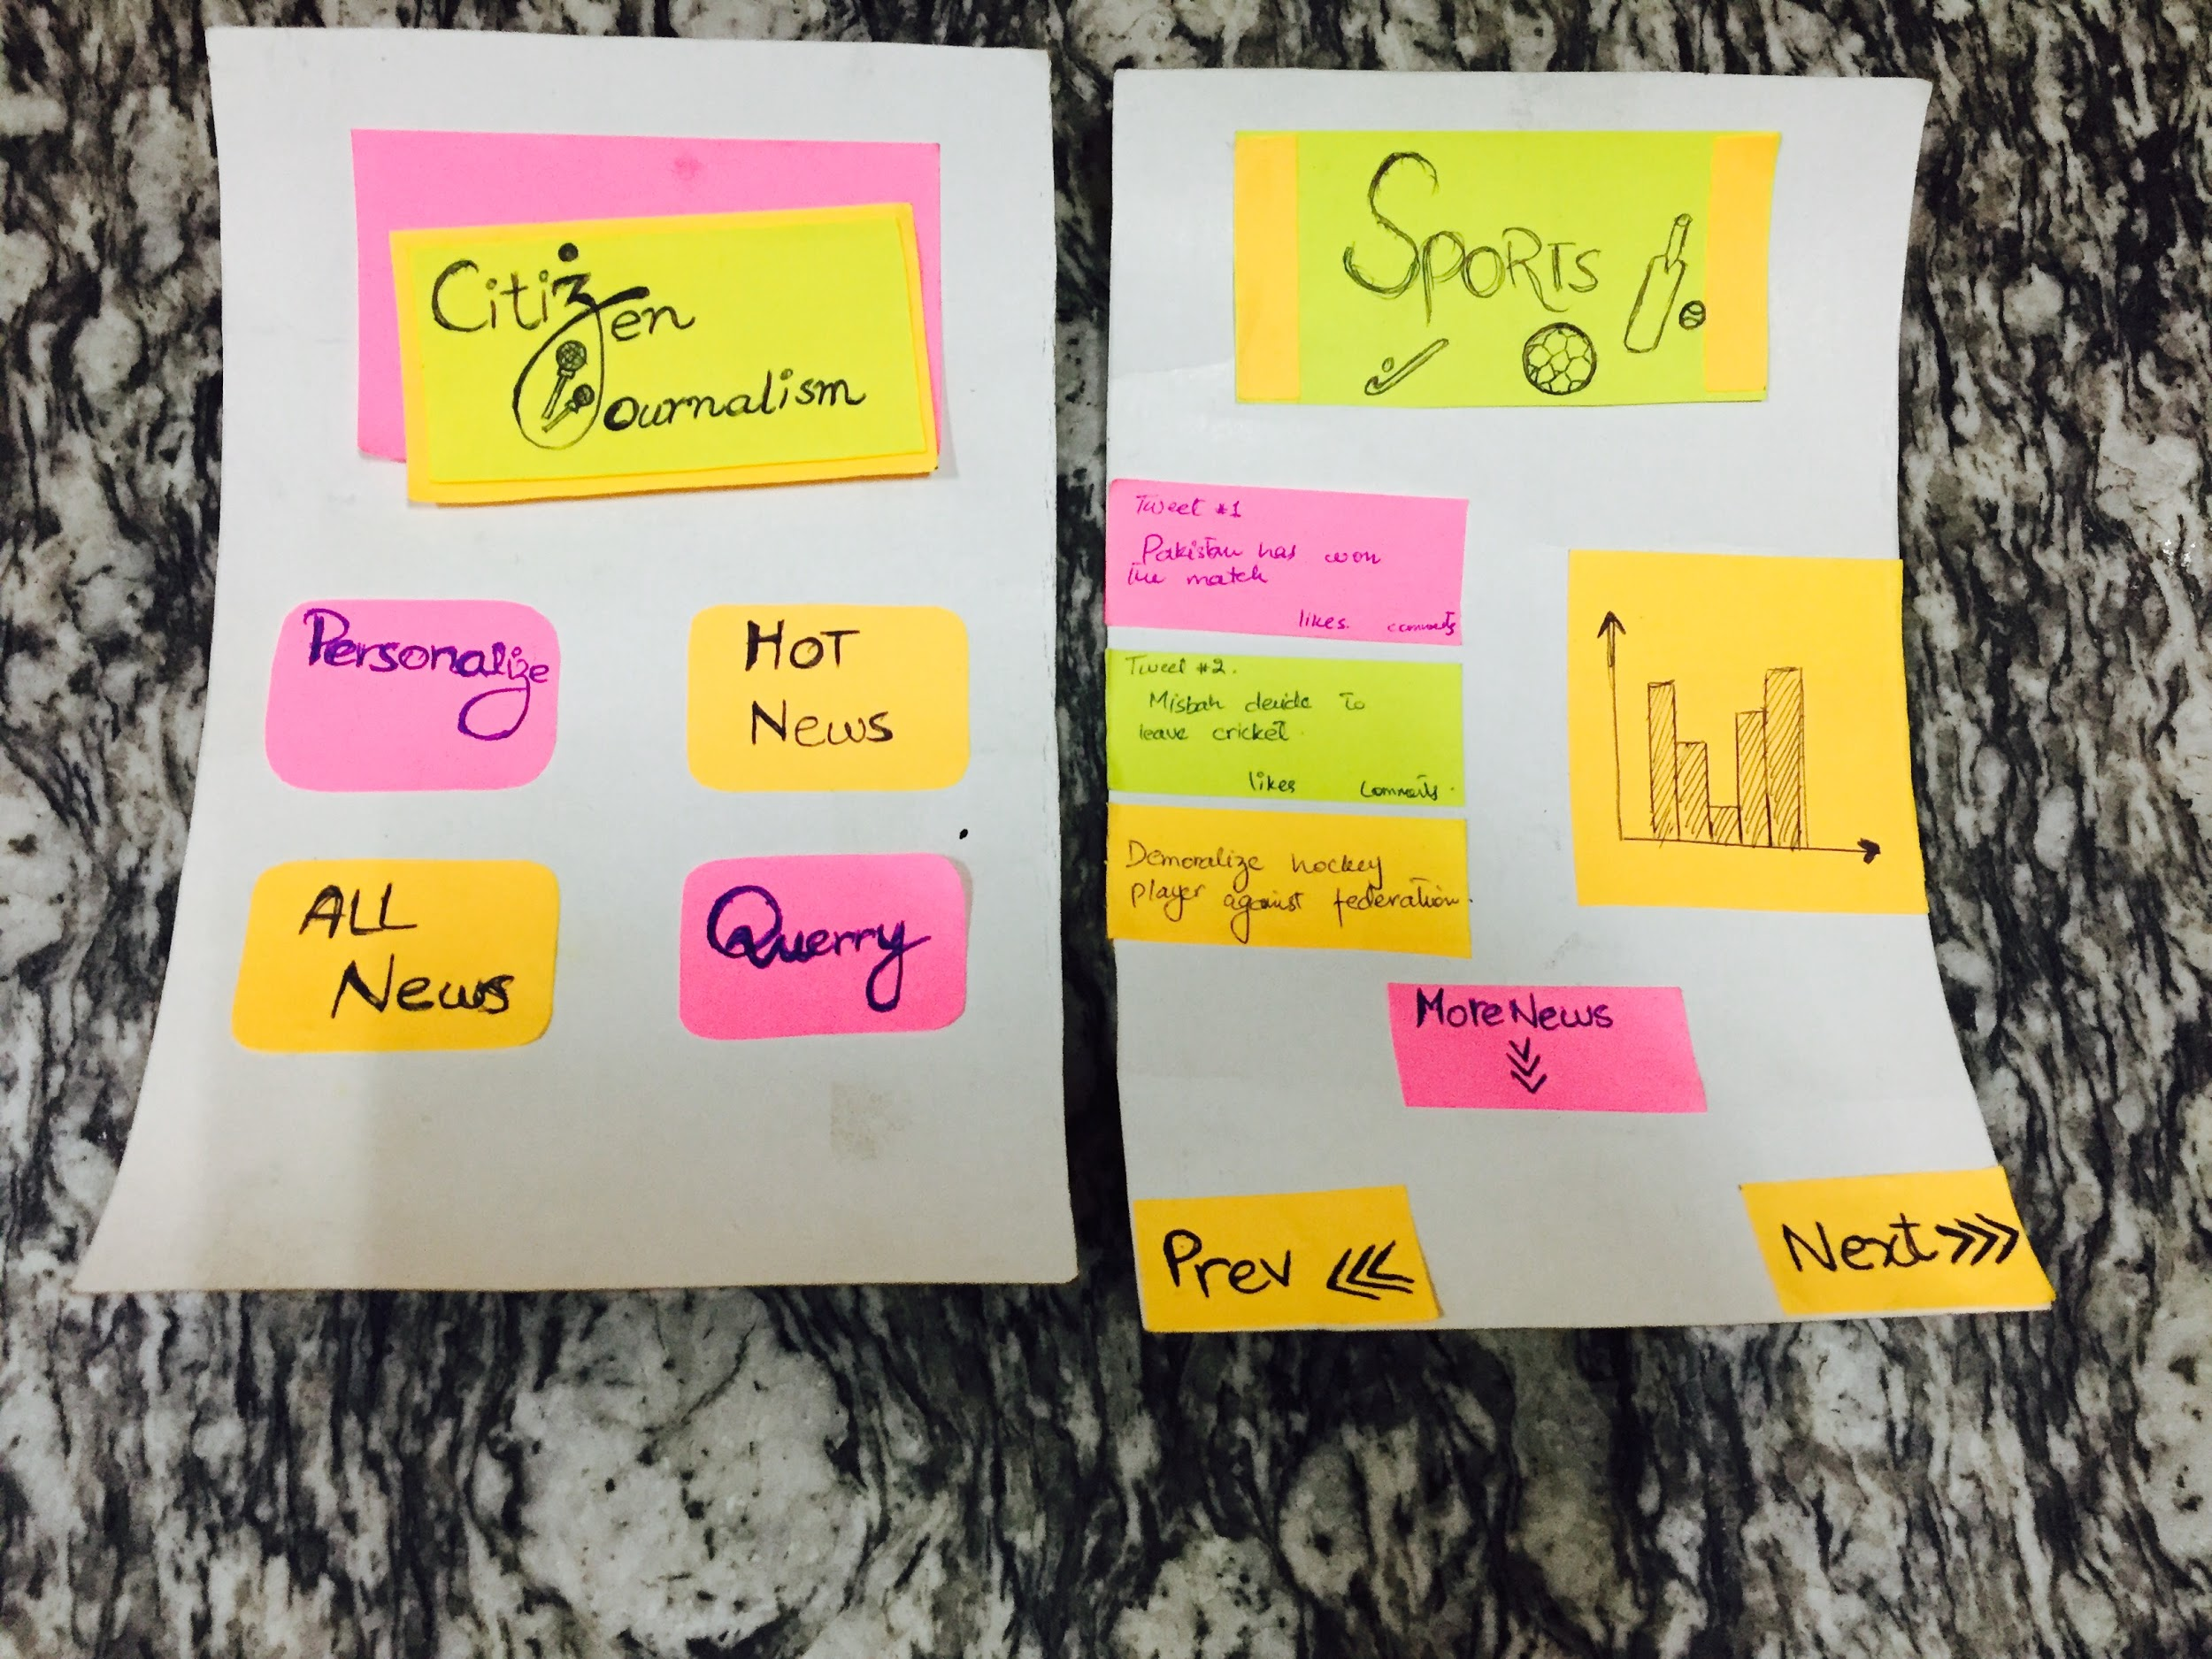
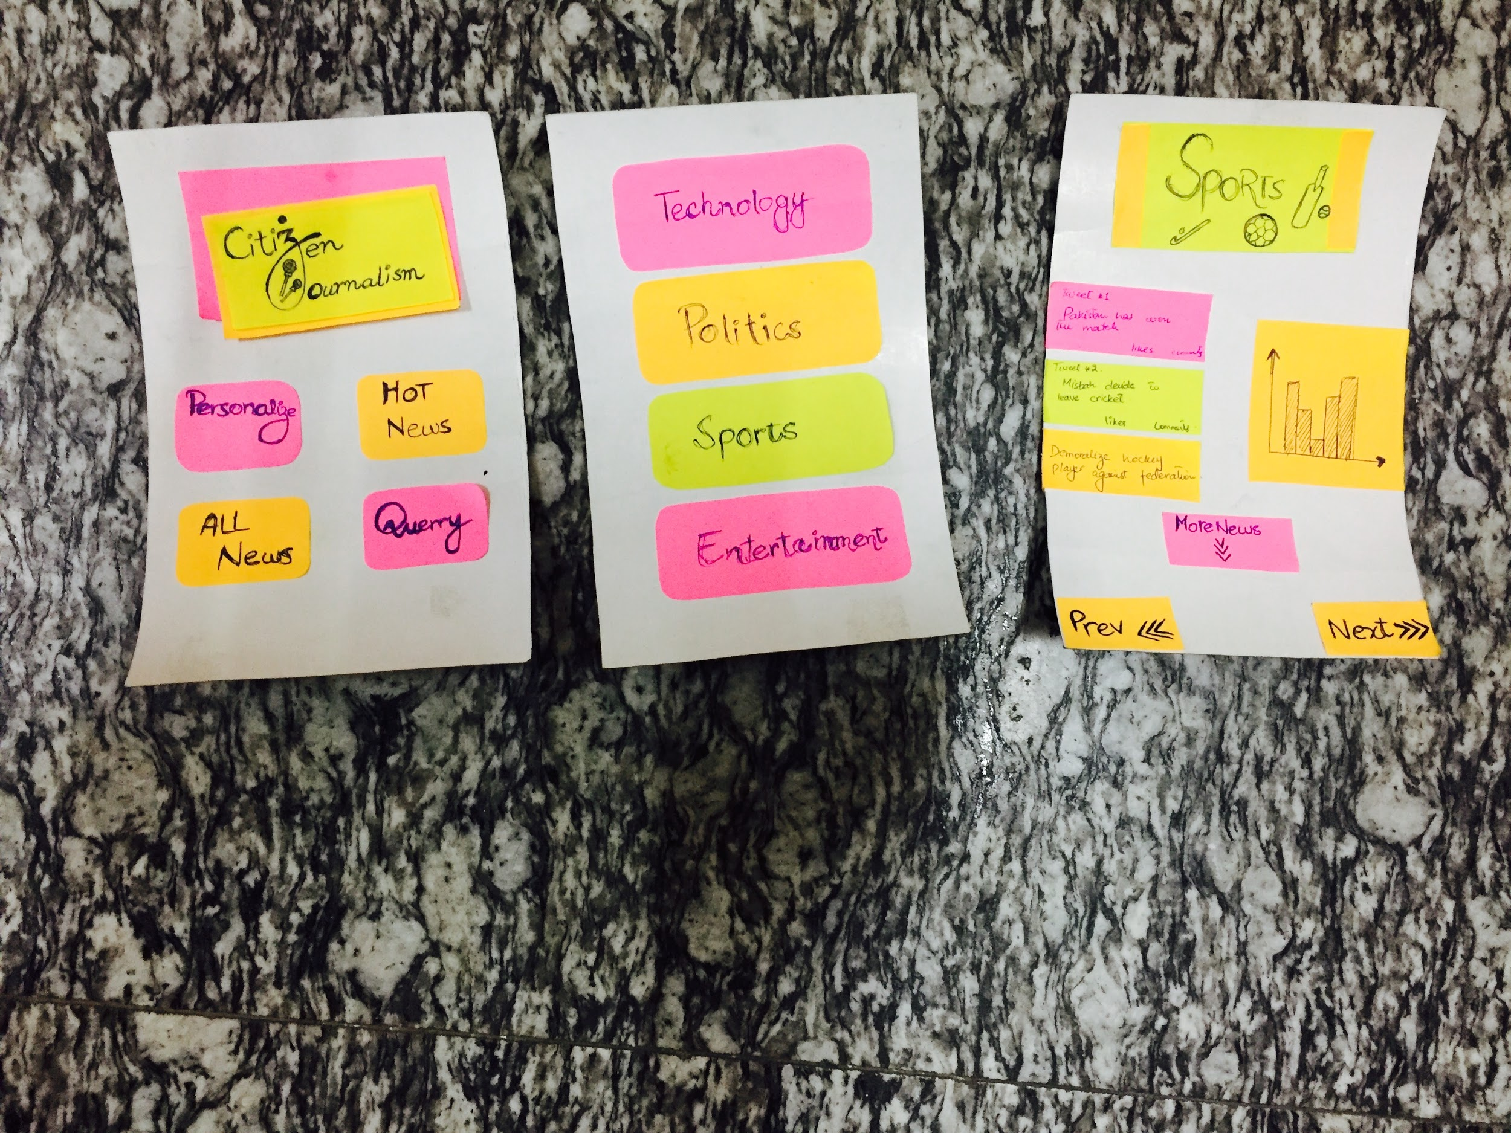
Storyboarding
Simple
Medium

Slide 7
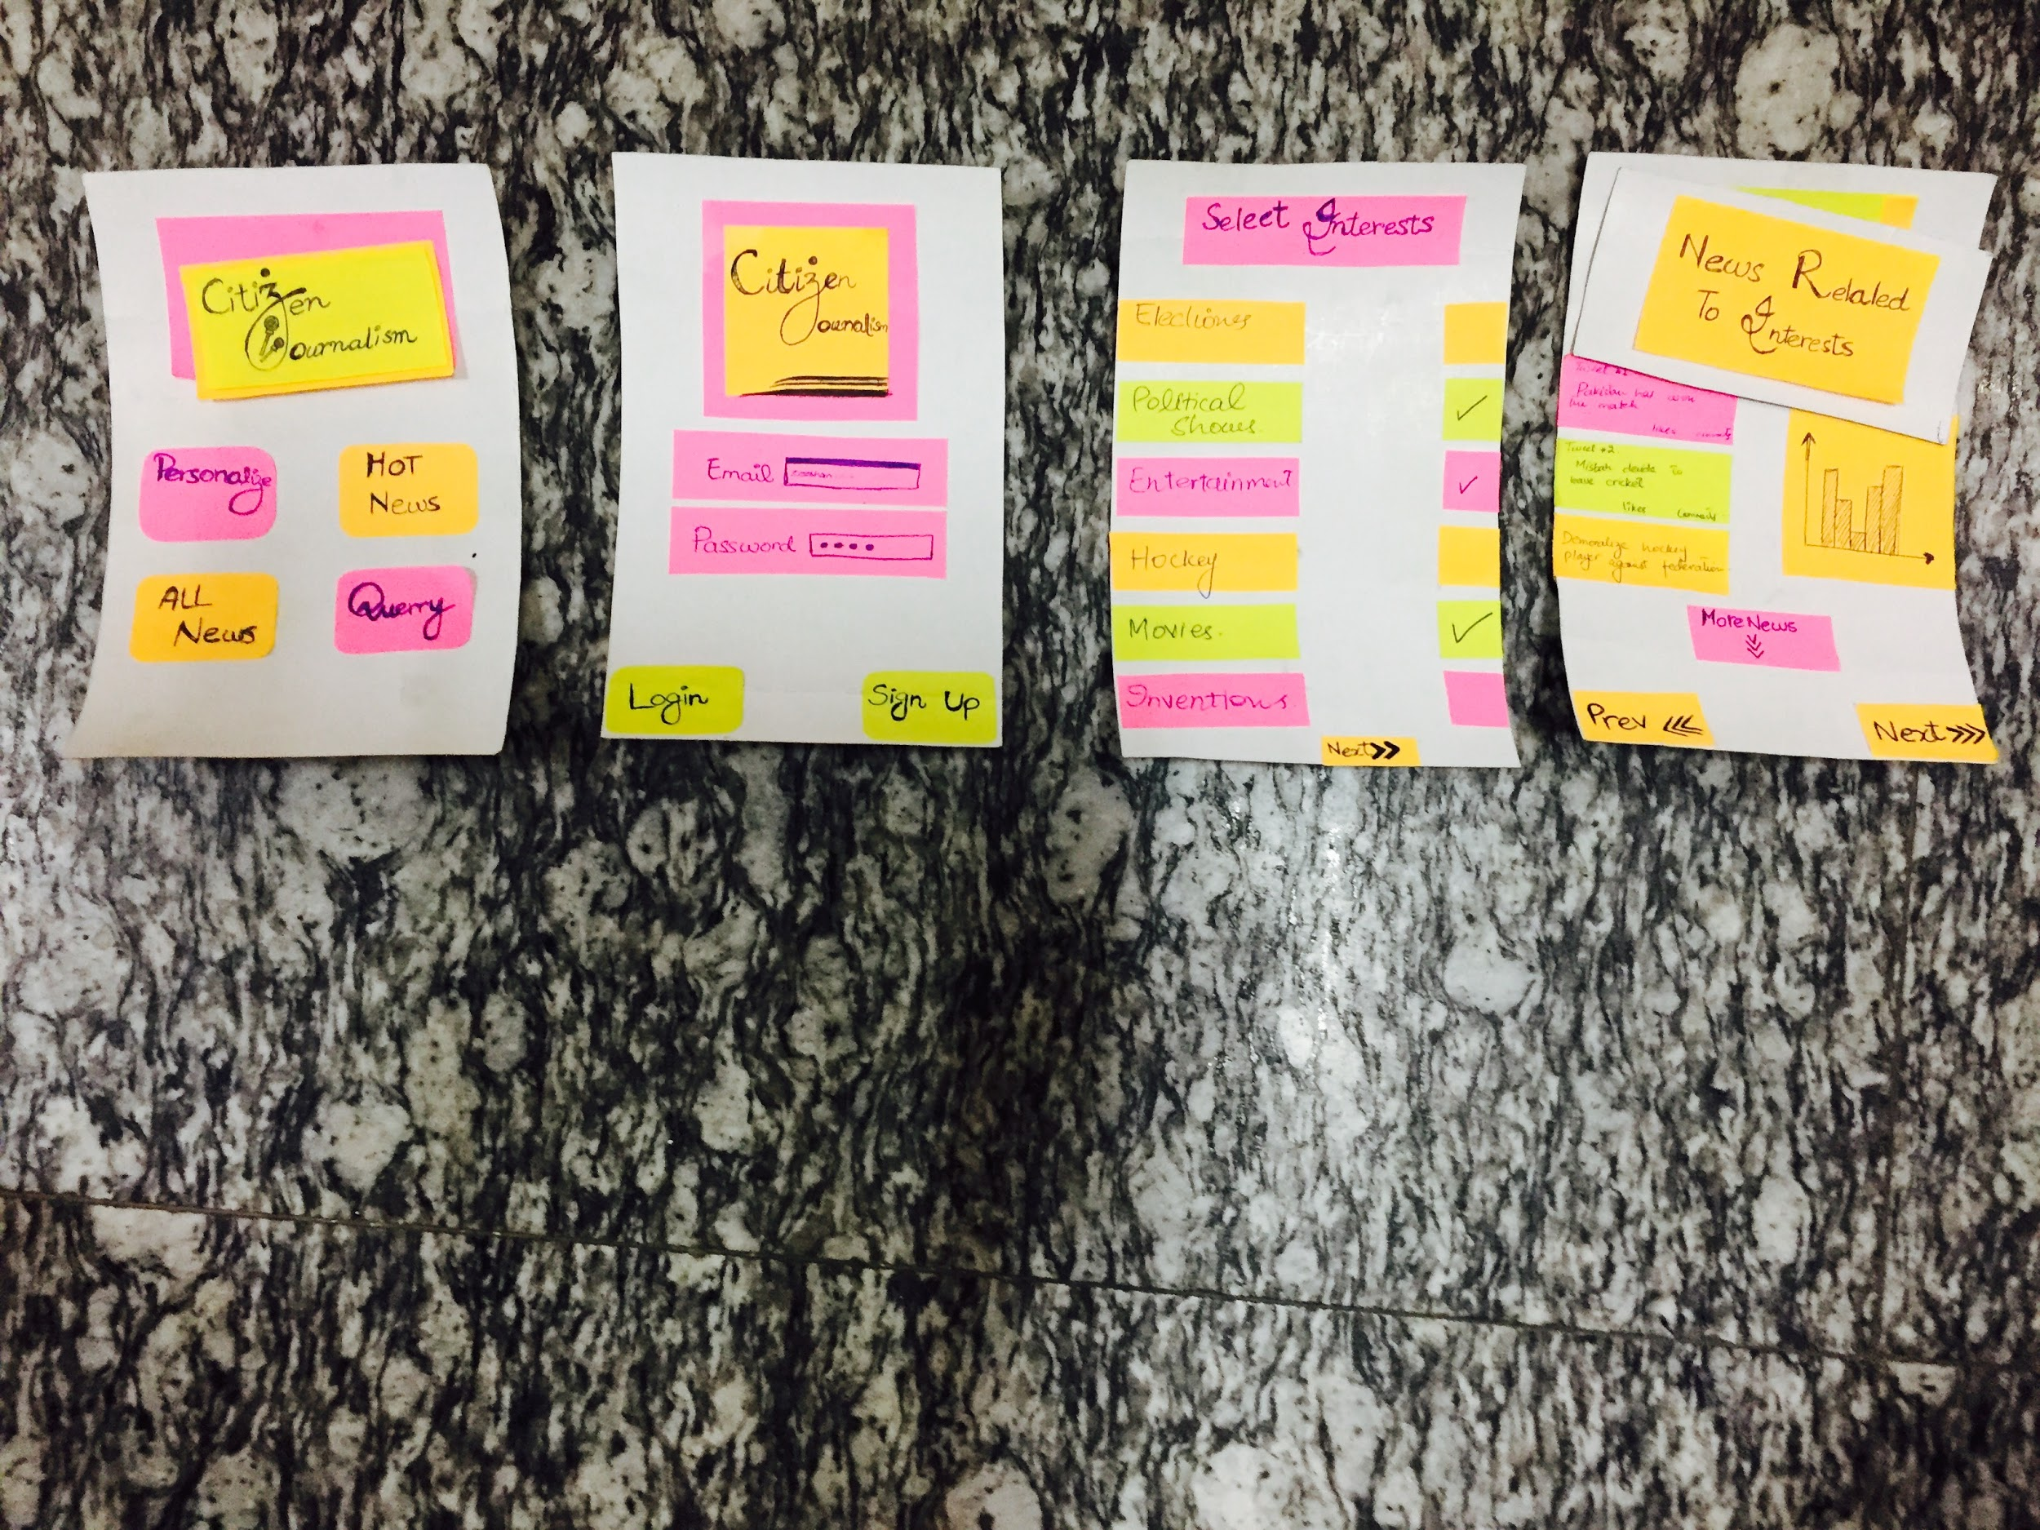
Storyboarding
Complex

Slide 8

Questions

Slide 9
Concept Video Link Youtube
https://www.youtube.com/watch?v=SiwLQVnivtc&feature=youtu.be

